Slide 1

Workshop Arduino
By Miguel Silva & Vinicius Pirassoli

Slide 2
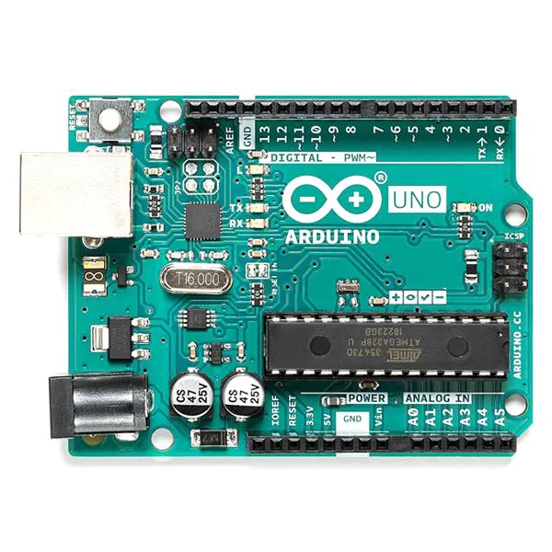
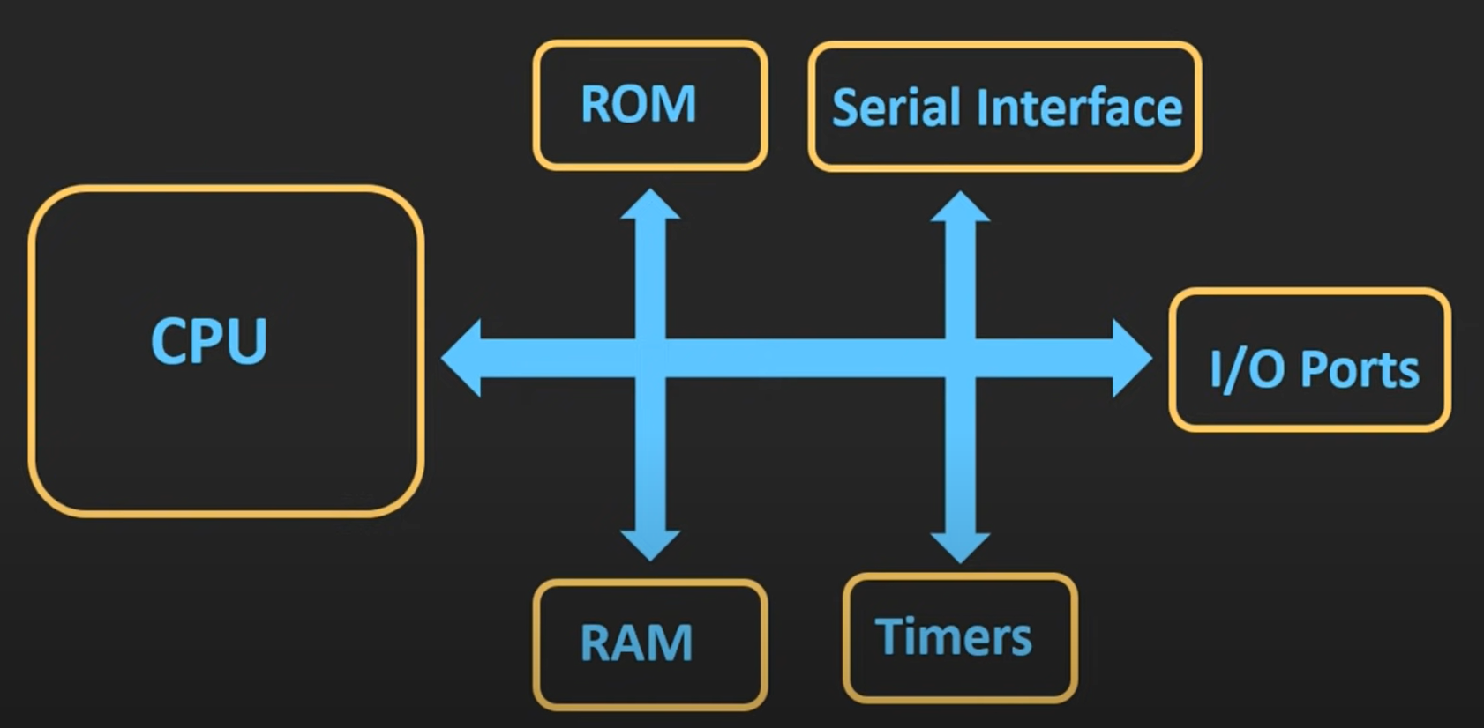
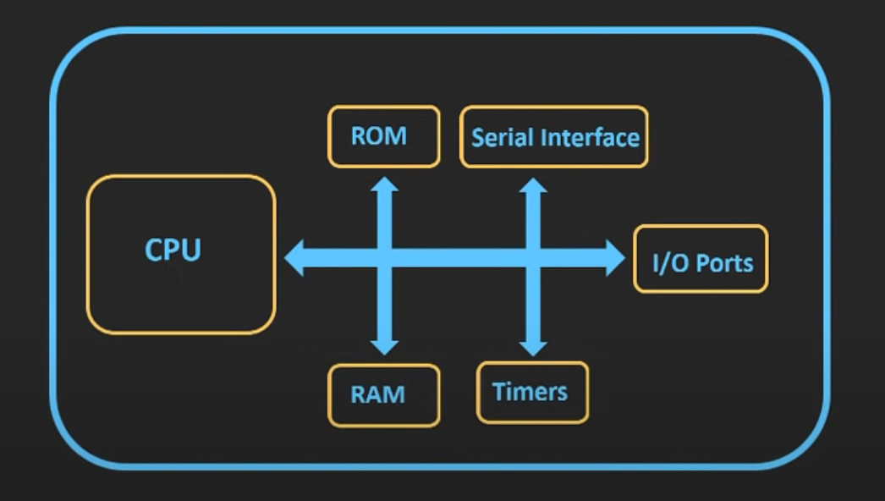
What is a Microcontroller?
VS

Slide 3
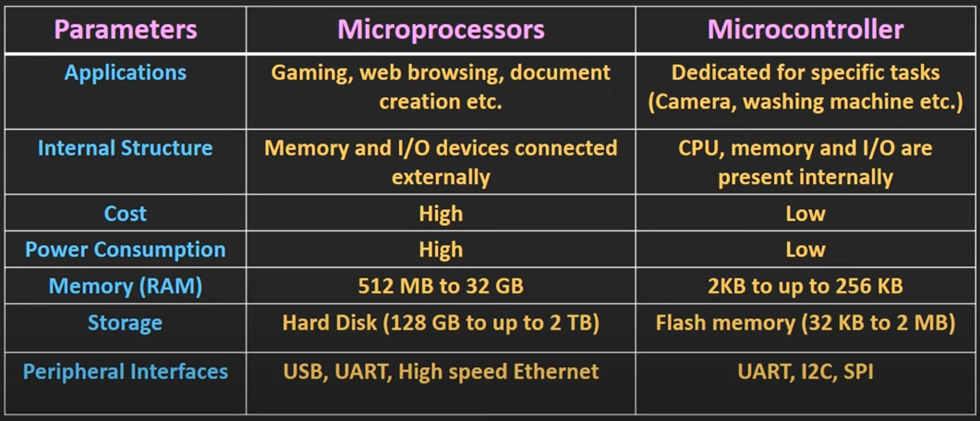
Why use a Microcontroller?
Real time processing
Low Power Consumption
Small Size
Cost-effective

Slide 4

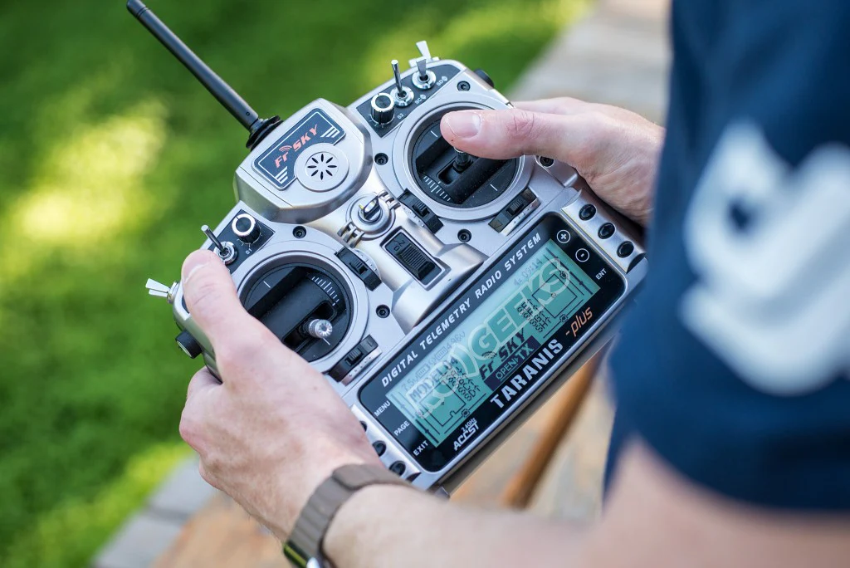
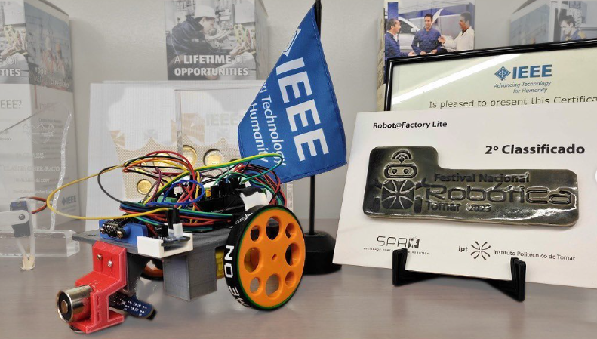

Use Cases of a Microcontroller

Slide 5
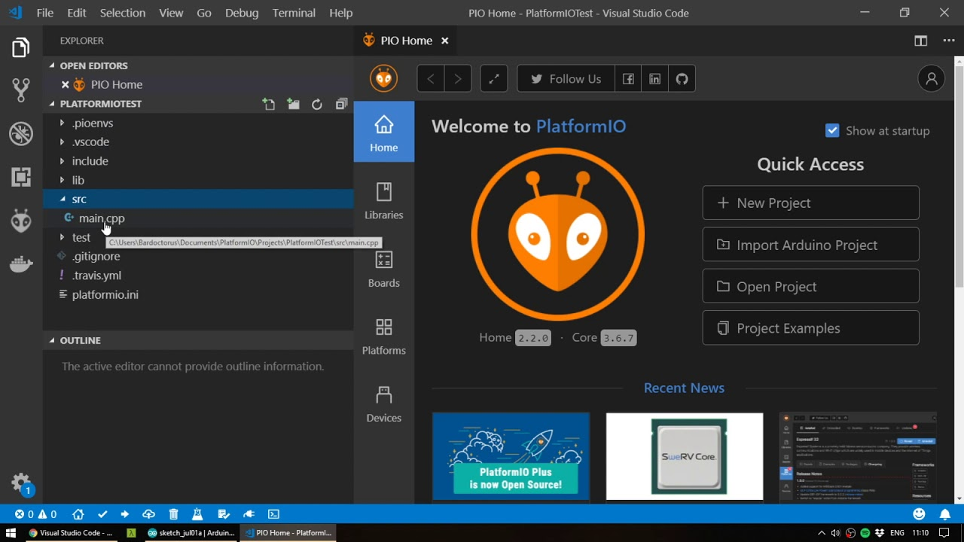
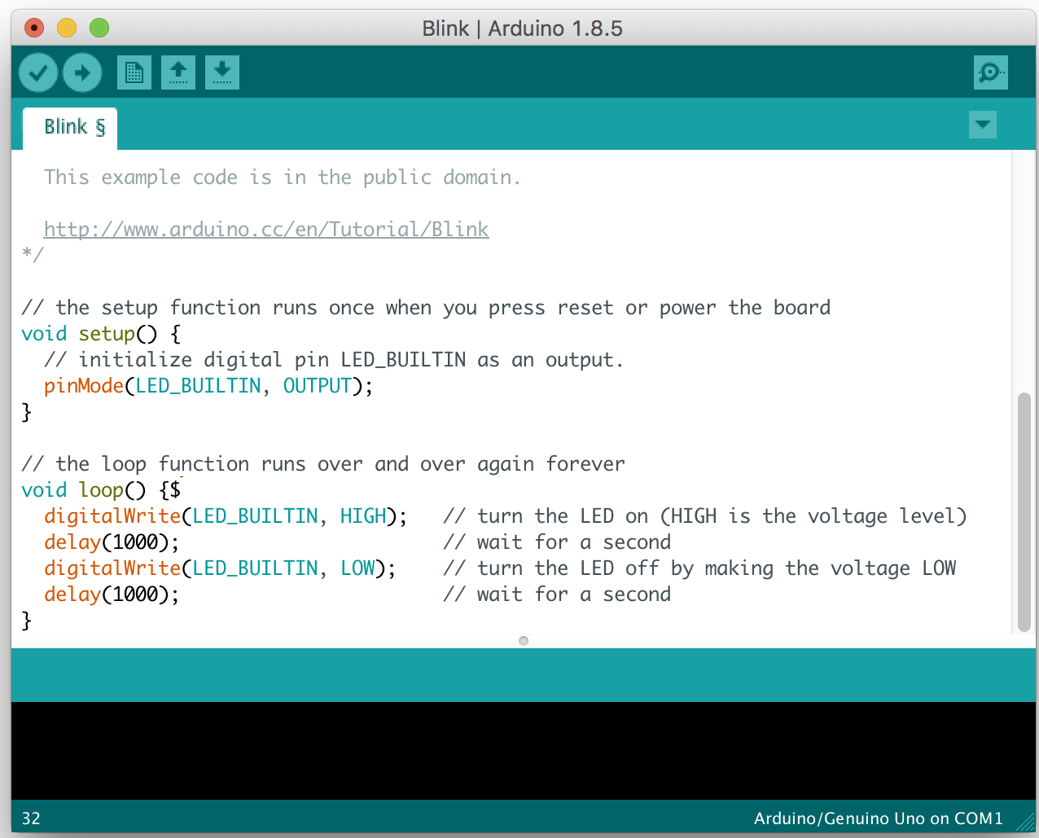
Frameworks
Let’s see if you indeed installed the frameworks before the Workshop, as requested 😌
Notes:
How to create a project
Advantages of each IDE
Can also use the cli
Barra azul do PIO

Slide 6
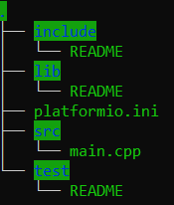
PlatformIO organization
Include - system libraries
lib - Custom made libraries
src - Main code
test - Store code
platformio.ini - Build and Run parameters
Notes:
Lib libraries can be called with <>

Slide 7
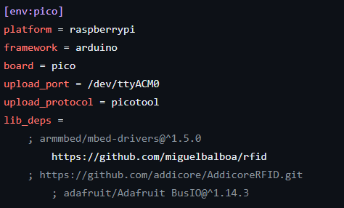
PlatformIO .ini
Notes:
Some examples of arguments going on the .ini
In linux is absolutely necessary to specify the port, otherwise wont work
Windows sometimes auto detects the port

Slide 8
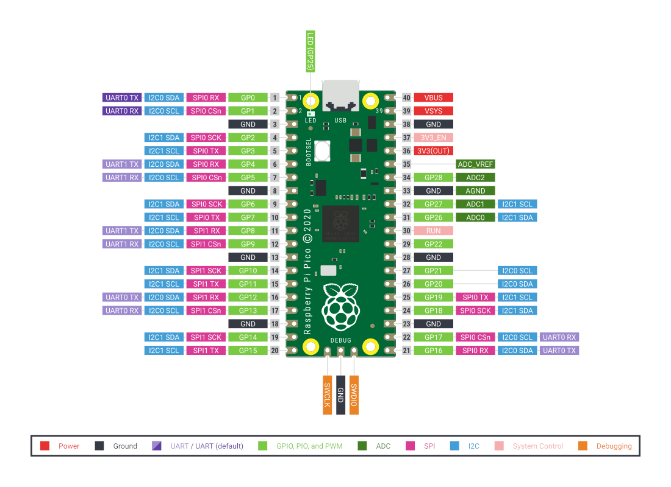
GPIO
Notes:
What each pin does and means

Slide 9
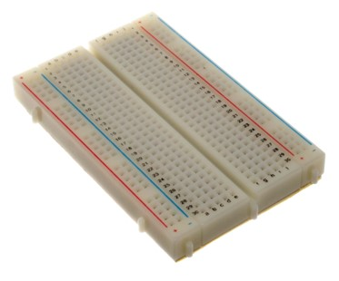
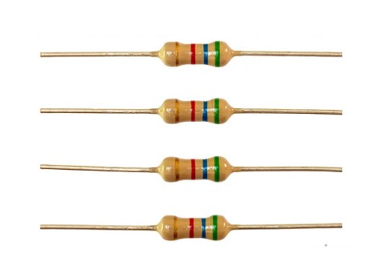
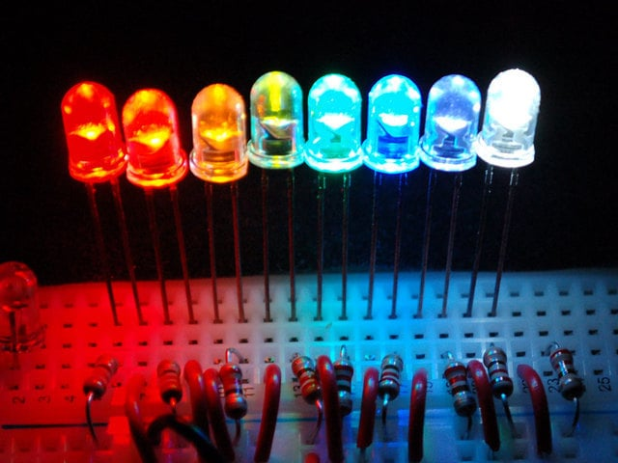
Materials / Modules (1)
Breadboard
Resistors
LEDs
Notes:
What each pin does and means

Slide 10
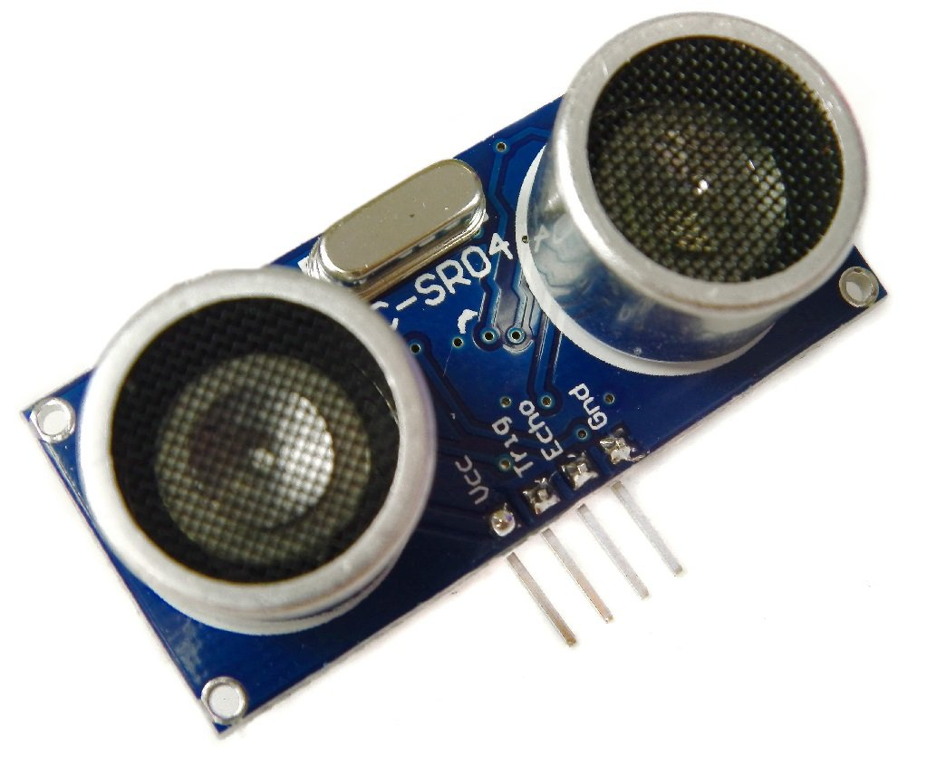
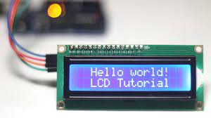
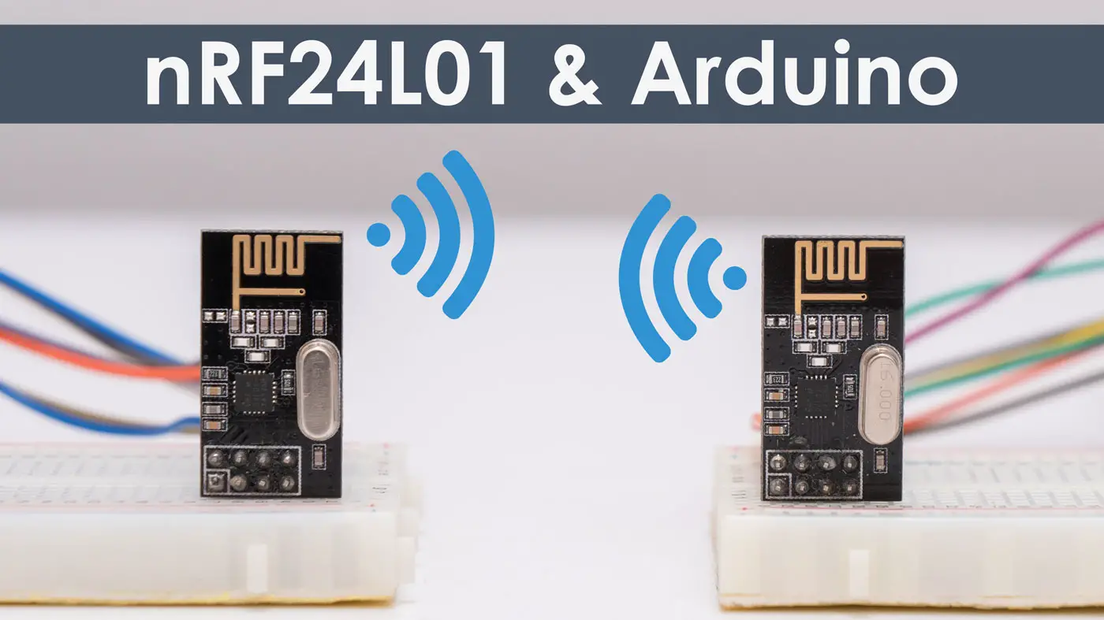
Materials / Modules (2)
Sonar Module
LCD Display
nRF24L01 module
Notes:
usam tanto i2c, como SPI ou serial
Either way ha muitas librarys disponiveis

Slide 11
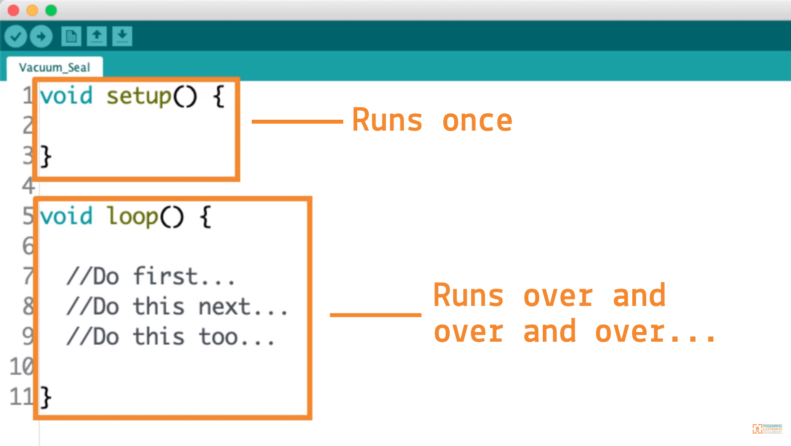
main.cpp

Slide 12
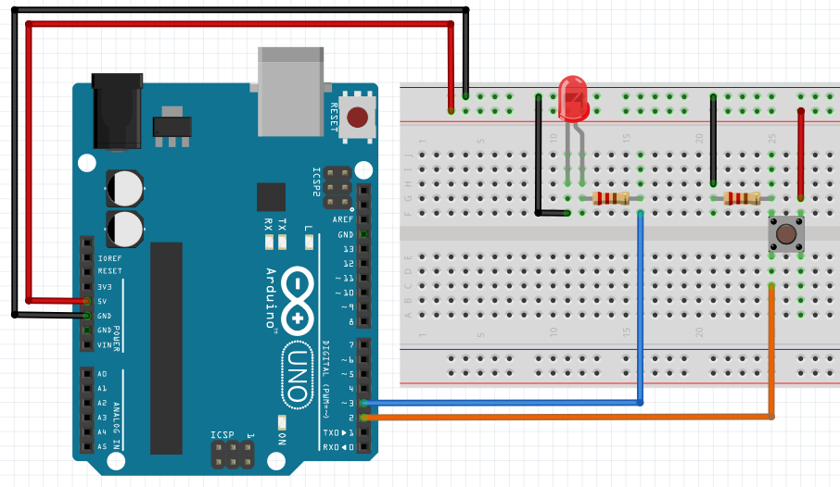
Let’s perform some connections!
Notes:
Add a variable resistor to the party
Different GPIOs
Each searches for their own pinout

Slide 13
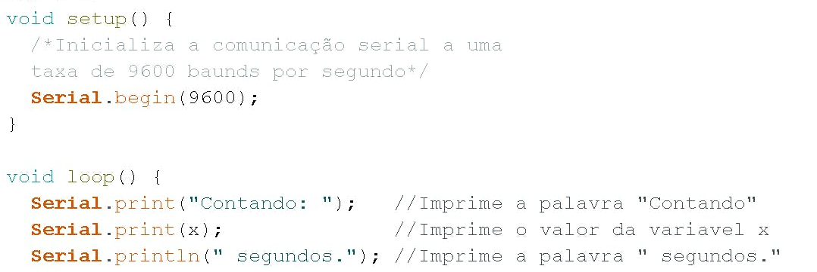
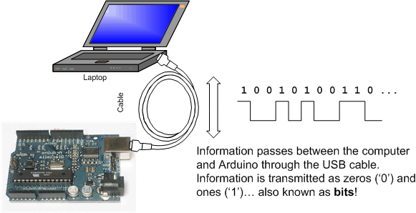
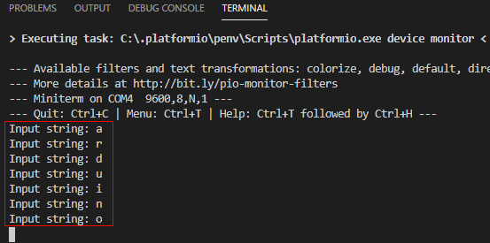
Serial Communication
Shortcut:
CTRL + ALT + M
Notes:
Falar Baud rate
Falar Serial.printf();

Slide 14
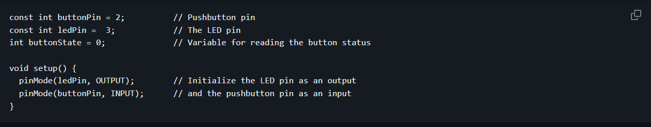
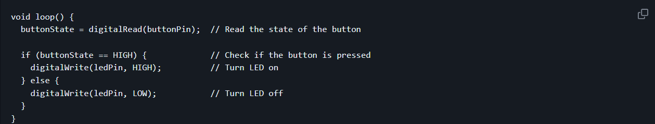
GPIO: digitalWrite & digitalRead

Slide 15
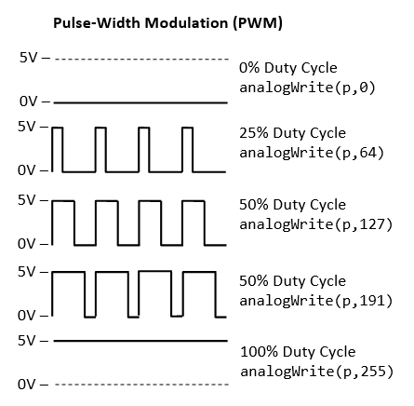
GPIO: PWM

Slide 16
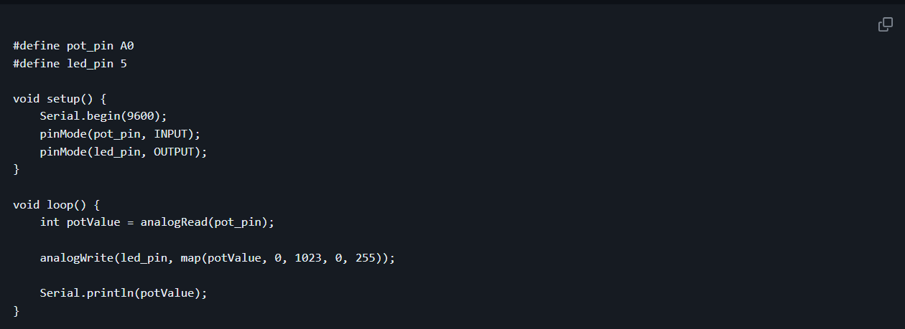
GPIO: analogRead & analogWrite
Notes:
0 a 1023
O que faz a função map

Slide 17
Let’s get our hands on the pasta!
Access the workshop GitHub page:
(ADD LINK)
Start by doing exercises 1 and 2!
Notes:
Will only have the exercises on git
1 - button and led
2 - add resistor and change LED intensity. Also print on Serial
3 -

Slide 18
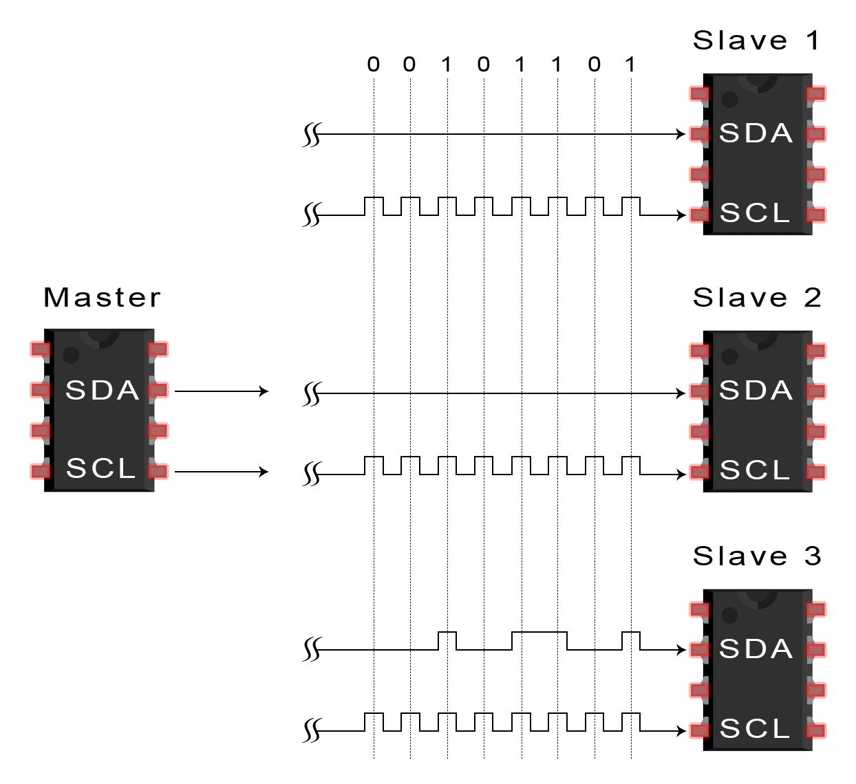
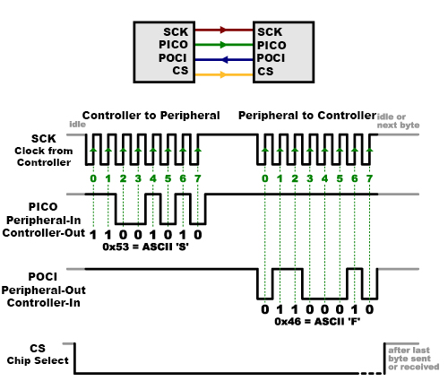
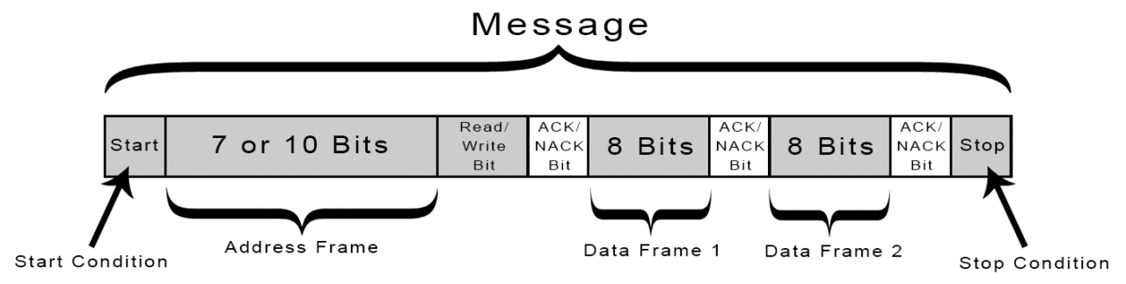
I2C & SPI

Slide 19
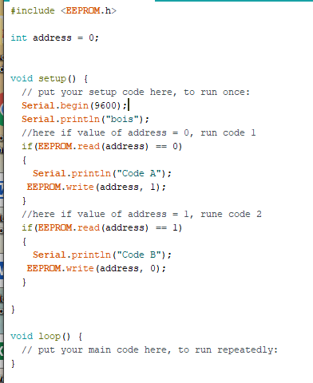
EEPROM
EEPROM stands for electrically erasable programmable read-only memory.
If we want to store long term data in our microcontroller, we can store it in the EEPROM.
It can be an external chip or built-in to the microcontroller.
Notes:
This image sucks, get a better one

Slide 20
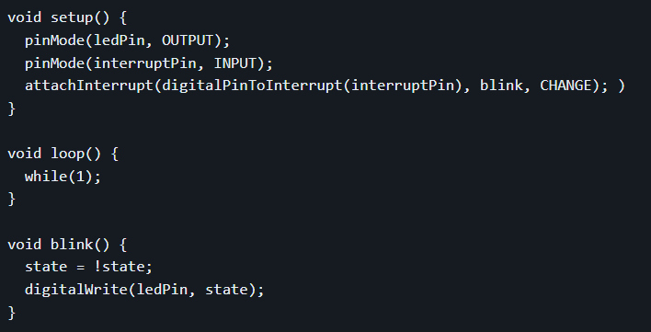
Interrupts
Whenever an interrupt is triggered, the controller stores the address of the current program counter (so it can go back to where it was when it finishes handling the interrupt) and goes to the address of the function who handles the interrupt (the interrupt service routine, ISR). After that, it returns to the program.
Know more about interrupts here:
https://github.com/ieeeupsb/workshop_ESP8266/blob/master/content/interrupts.md
Notes:
Why is it important? To use safety critical information

Slide 21
WatchDog Timers
The primary application of a watchdog timer is as a system monitor to detect and reset an "out of control" microprocessor. When program execution goes awry, it will not properly execute the code that restarts the watchdog. In such a case, the watchdog timer will time out and cause a microcontroller reset.
More about Watchdog Timers here: https://github.com/ieeeupsb/workshop_arduino/blob/2023/content/watchMePlease.md
Notes:
Why is it important? To use safety critical information

Slide 22
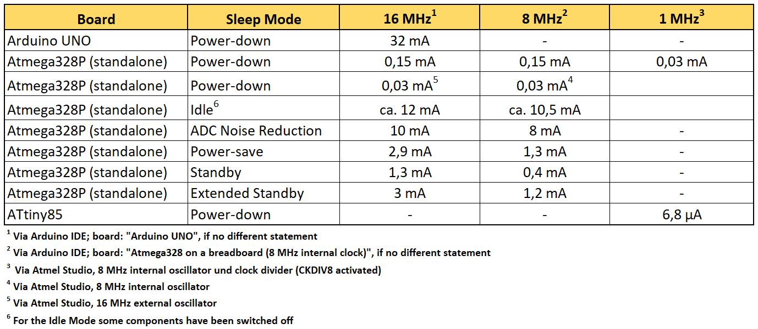
Low Consumption
Microcontrollers by definition use all of their capabilities to run. It happens that always running at full power requires a loooot of energy that we don’t have. So the solution is to get the microcontroller in Low Power consumption. There are several modes, and they are usually dependent on the microcontroller you are using, but let's see an example for the ATMEGA328P, the Arduino Uno chip:
Notes:
So much to say about this

Slide 23
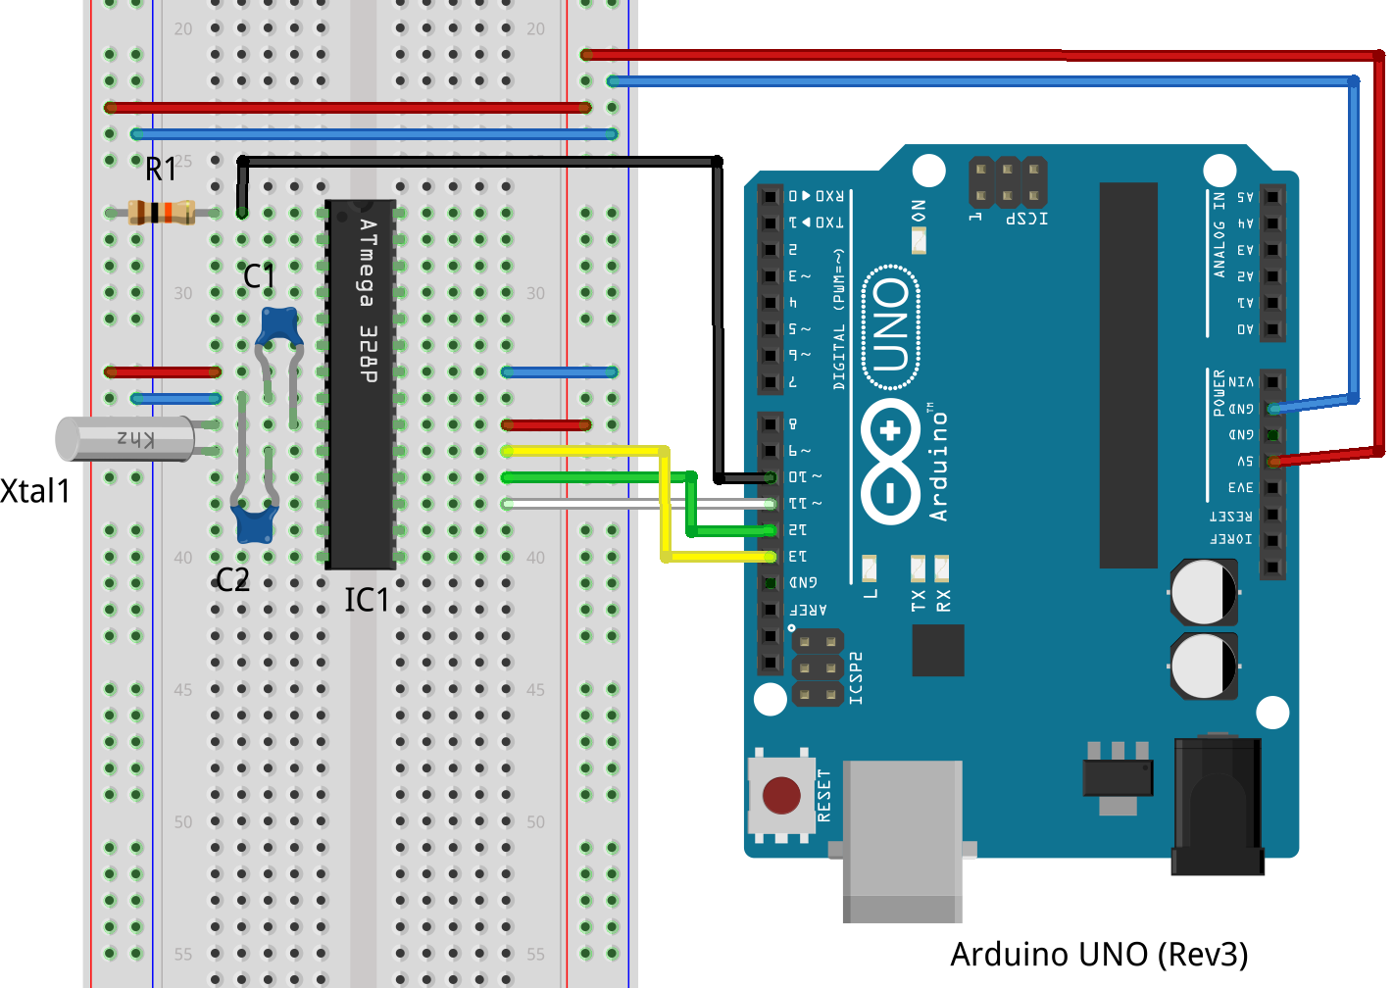
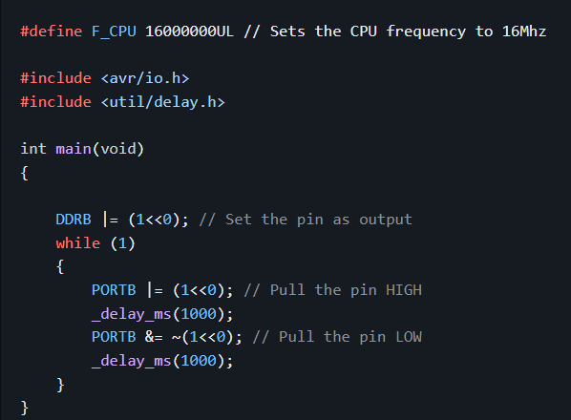
Standalone? What does that mean?
You are usually accustomed to see boards with a lot of pins, but it can also be just the chip. This involves another topic: register programming. If you want to take the most out of the consumption and timing capabilities of your microcontroller, this is what you do!
Notes:
Need to use arduino as programmer

Slide 24
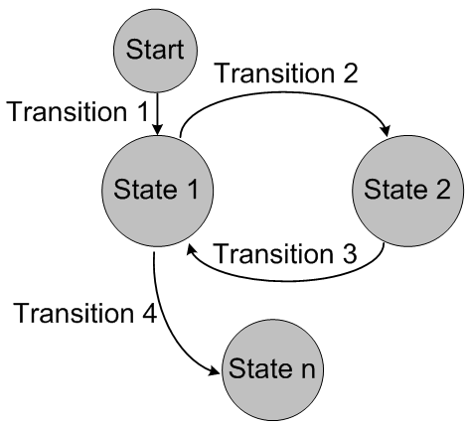
Complex Projects? - State Machines
Notes:
Maybe example on this?

Slide 25
Shortcuts:
PlatformIO:
CTRL + ALT + M - Open Serial Monitor
CTRL + ALT + B - Build the Code
CTRL + ALT + U - Run the Code
VSCode:
CTRL + K + C - Comment Line
CTRL + K + U - Uncomment Line
ALT + ARROW UP/DOWN - Move line around
More that Idk or remember :)
Notes:
Low

Slide 26
THE END!
Thank you for coming!

